Slide 1
Council of Graduate Coordinators and Staff (CGCS)
140 Toomey Hall
March 22, 2024

Slide 2
CGCS Agenda – Friday, March 22, 2024
1 pm – 140 Toomey Hall
December Graduate Faculty Meeting Update
Graduate Council Meetings Update
Updates from the Graduate Education Office
Audits and Degree Progression
Graduate Research Showcase
Deadlines

Slide 3
December Graduate Faculty Meeting
Approved - Policy Memo II-20 Recommendation:
Original Passage:
When a graduate student takes the master’s comprehensive exam, doctoral qualifying exam, doctoral comprehensive exam, or defends their thesis/dissertation, they must be enrolled on the date of the exam/defense. Failure to do so may invalidate the exam/defense. If the exam/defense occurs during the intersession2, then an examination-only fee is appropriate by enrolling in one credit hour of Oral Examination, 5040/6040.
Proposed Revision:
When a graduate student takes the master’s comprehensive exam, doctoral qualifying exam, doctoral comprehensive exam, or defends their thesis/dissertation, they must be enrolled on the date of the exam/defense. Failure to do so may invalidate the exam/defense. If the exam/defense occurs during the intersession2, the student must have been enrolled in the immediate preceding semester/session; or, prior to the exam/defense date, they must enroll in one credit hour of Oral Examination, 5040/6040 (charged as an examination-only fee).

Slide 4
Graduate Council Meetings
Modify and expand current Grad Track Pathway program (BS to PhD program)
Changes to admission process
Students admitted into GTP program through Slate (Admissions Office)
Students submit course listing on form (Graduate Education)
Remove all or nothing requirement of shared credit-allows student to include any combination of the designated courses that they receive an A or B in.

Slide 5
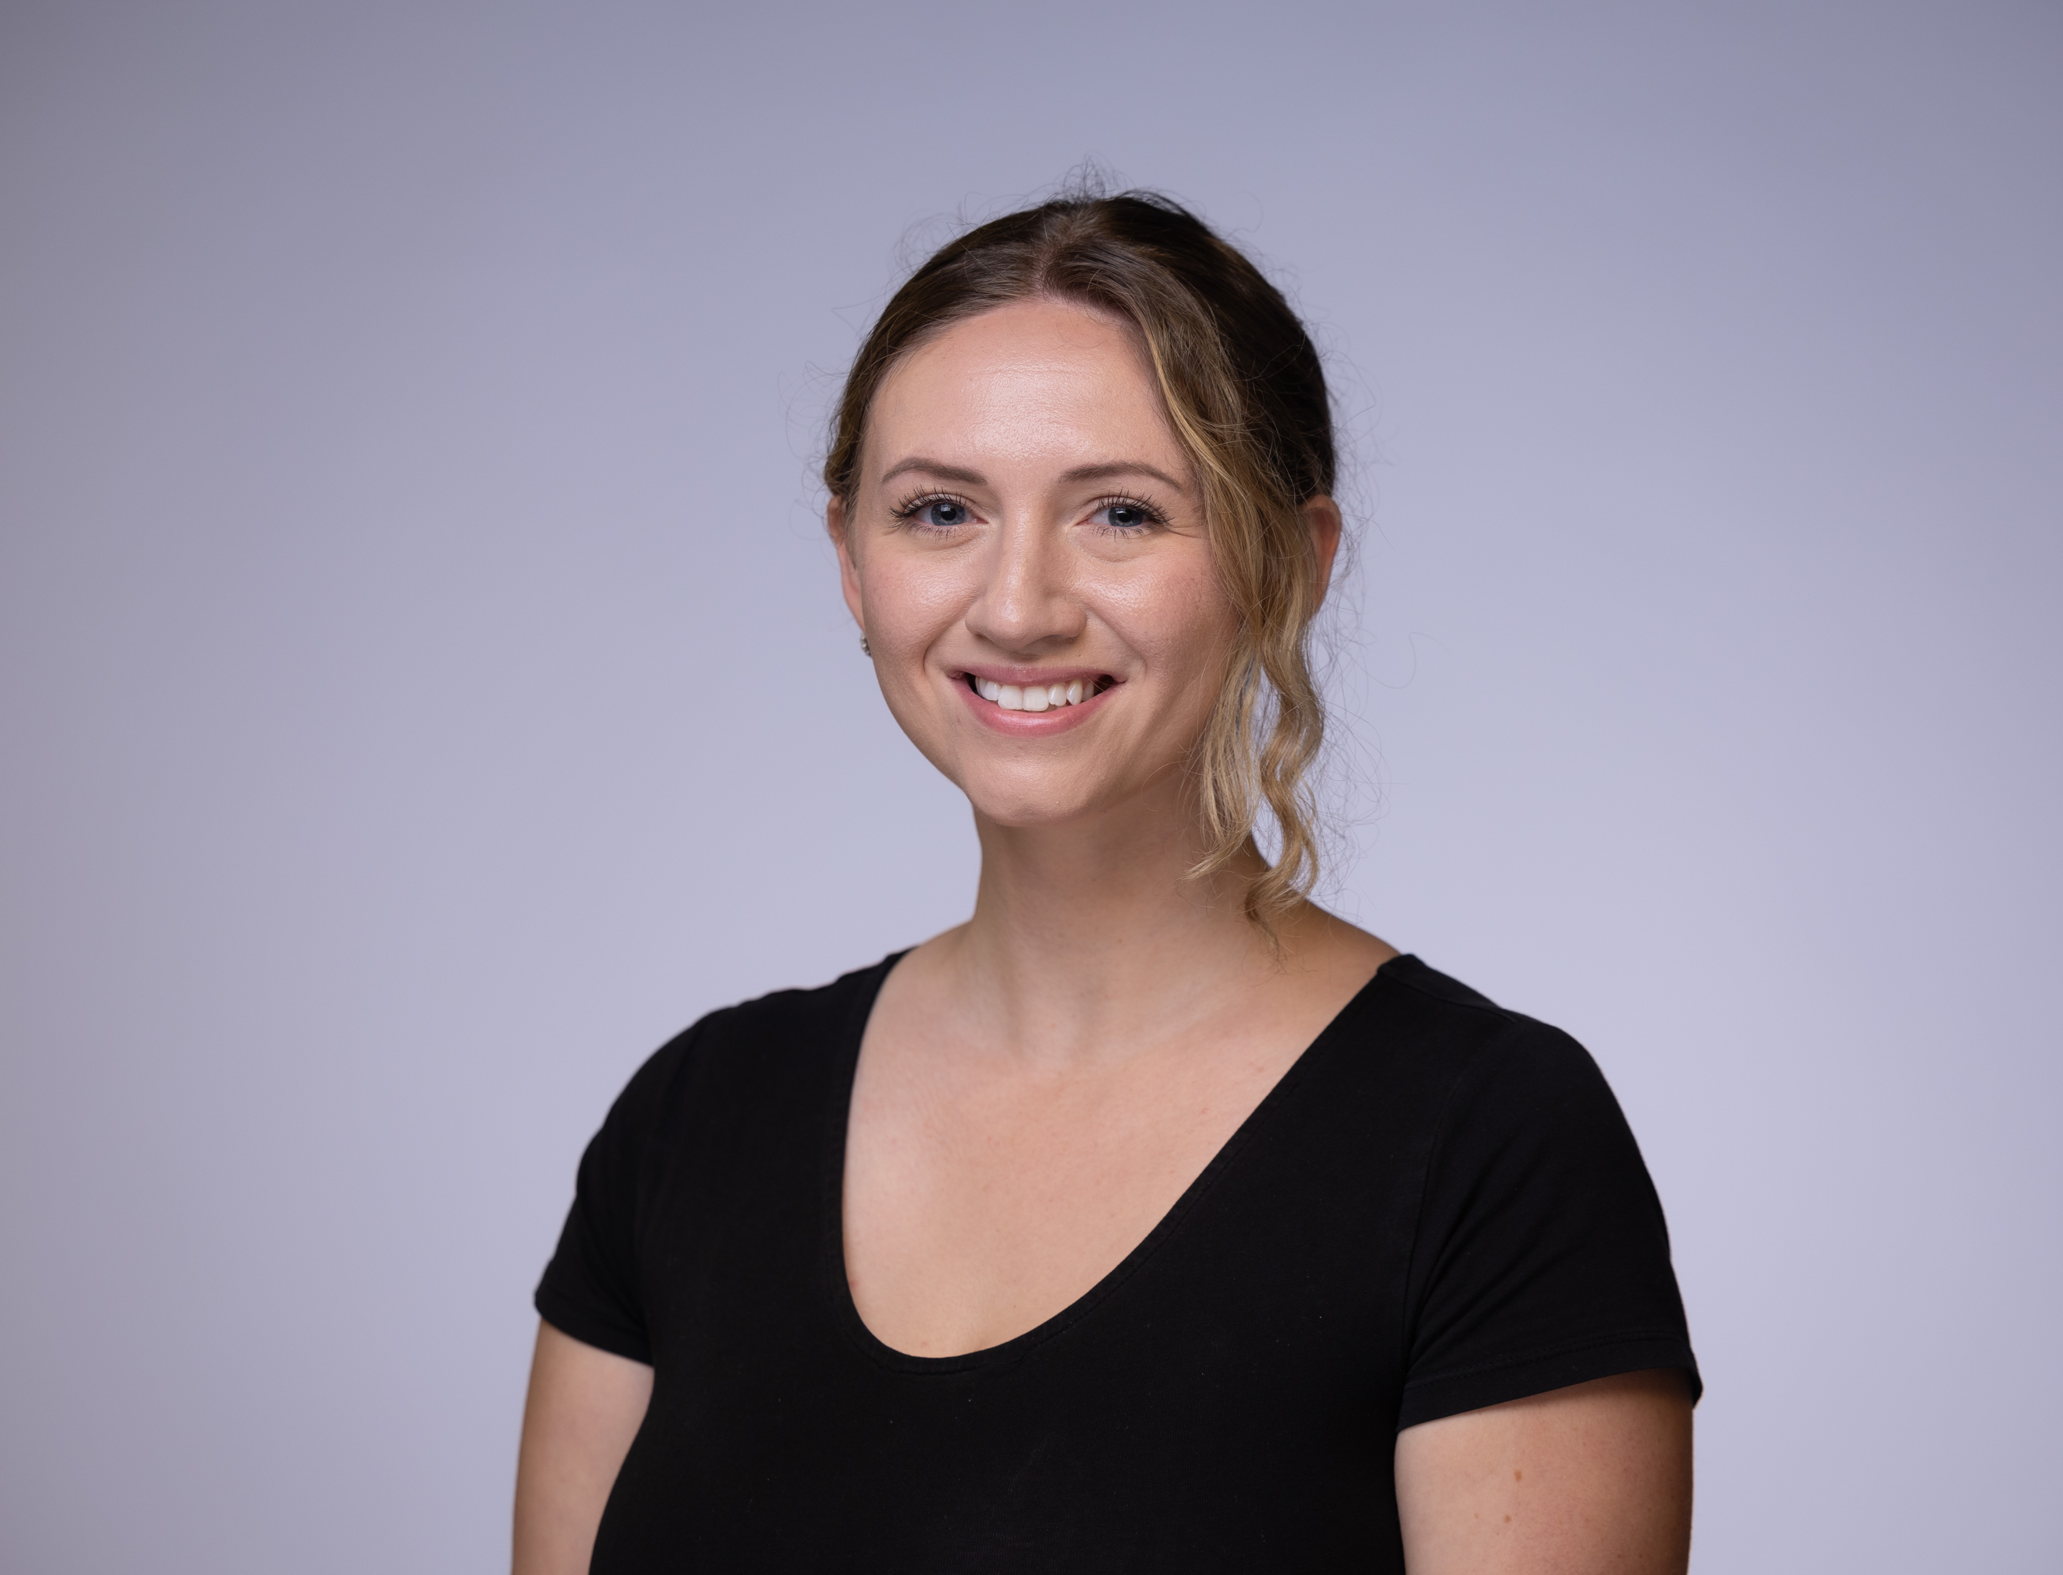
Graduate Education - Update
New Staff – Welcome Charlene Kean, Graduate Specialist
Advise students (last names M - Z), faculty, and staff on rules and requirements outlined in the Graduate Catalog and Chancellor’s Policy Memo II-20: Graduate Student Registration
Process graduate student forms and build degree audits to monitor degree progress
Approve final degree audits for graduate degrees/certificates to be awarded
Review format of theses/dissertations
Provide support and serve as liaison for Graduate Council and Graduate Faculty
Provide training to new staff on processes related to graduate student support

Slide 6
Graduate Education - Update
Website Updates
Edits to grad.mst.edu
Links realigned
Resources for current students
Navigating the degree program
Timelines added
Requirements outlined
Graduation checklist updated
Additional resources and updates to FAQs are still under construction

Slide 7
Graduate Education - Update
Graduate Student Forms
Update to Process – Beginning June 1
Departments/students will no longer receive a copy of the form when it is approved by Graduate Education.
The forms are often corrected by the graduate specialist before they are approved therefore the copy that is returned after approval is not correct
Final approved forms can be found in Perceptive

Slide 8
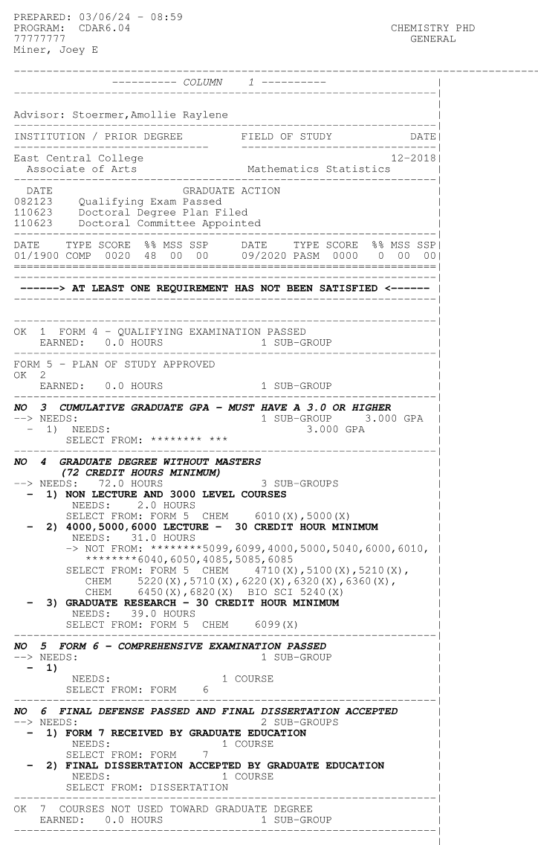
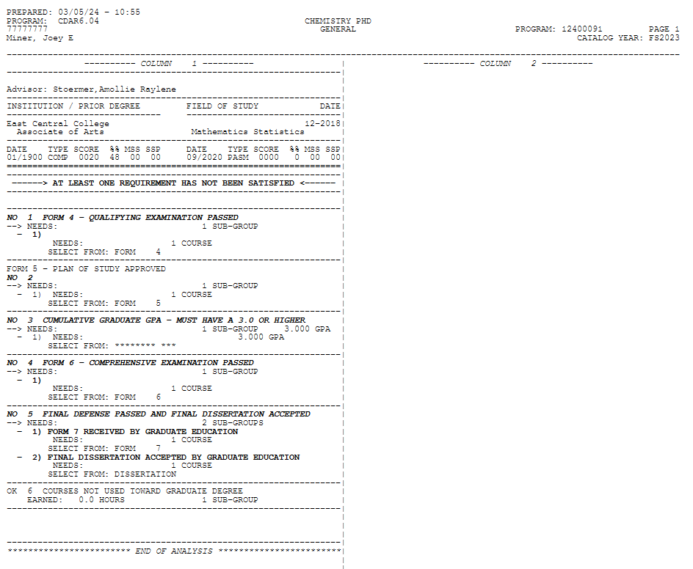
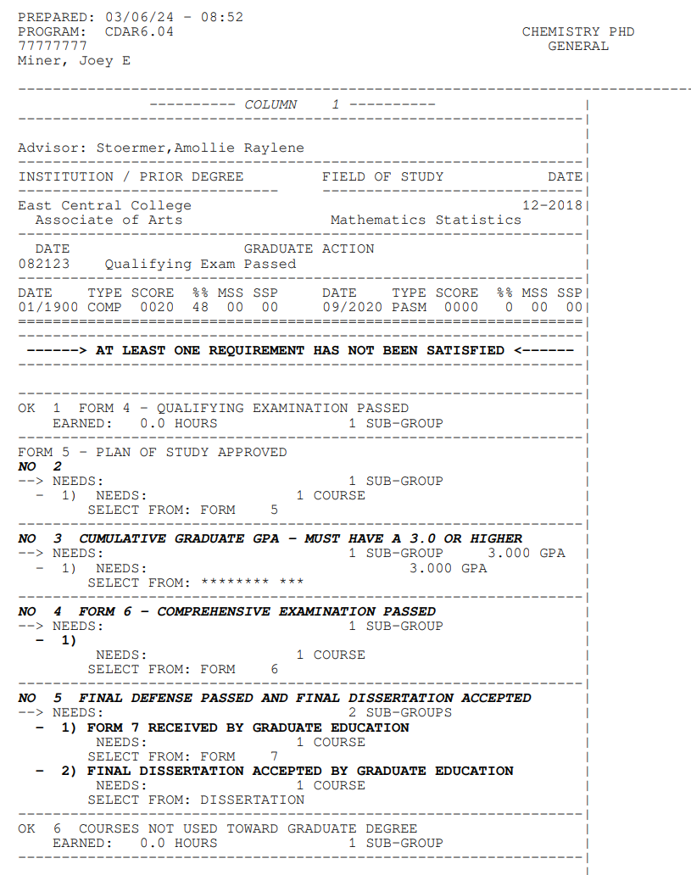
Tracking degree progress using degree audits
New student, Joe Miner, admitted FS2023, Chemistry Ph.D.
Joe works with his advisor to formally plan the reminder of his degree program and select an advisory committee, Form 5 is submitted and approved on 11/06/2023.
Joe successfully completes his qualifying exam on 08/21/2023. Form 4 is submitted and approved.

Slide 9
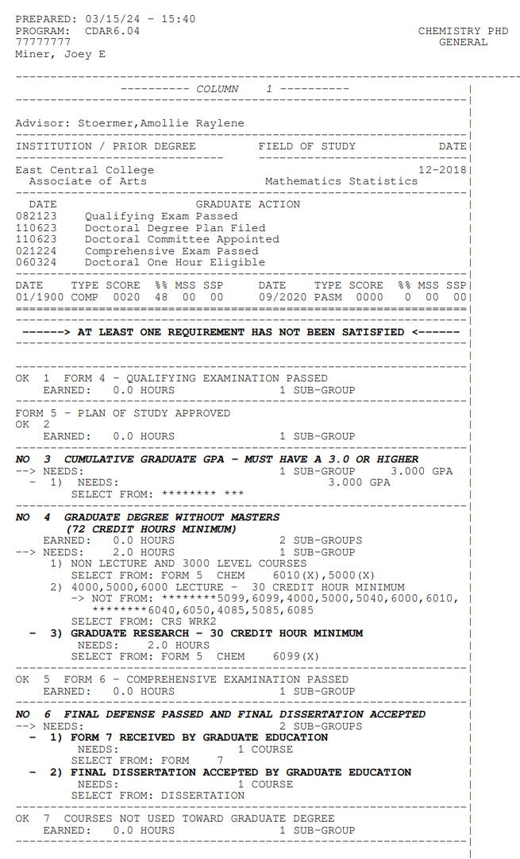
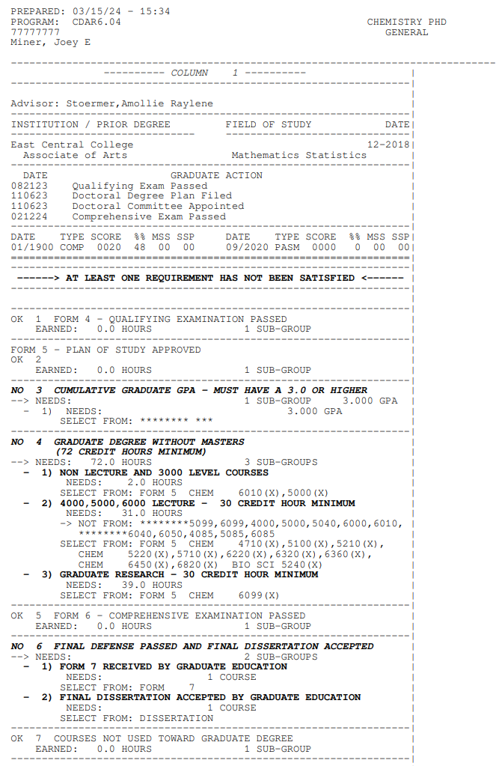
Tracking degree progress using degree audits (cont.)
Joe submits a Form 5A to update his plan of study. Adds one-hour of enrollment beginning summer 2024.
Joe successfully completes his comprehensive exam on 2/12/2024. Form 6 is submitted and approved.
Joe works with his advisor and committee to schedule his final defense and submits the details of the exam to Graduate Education ten days before his exam.

Slide 10
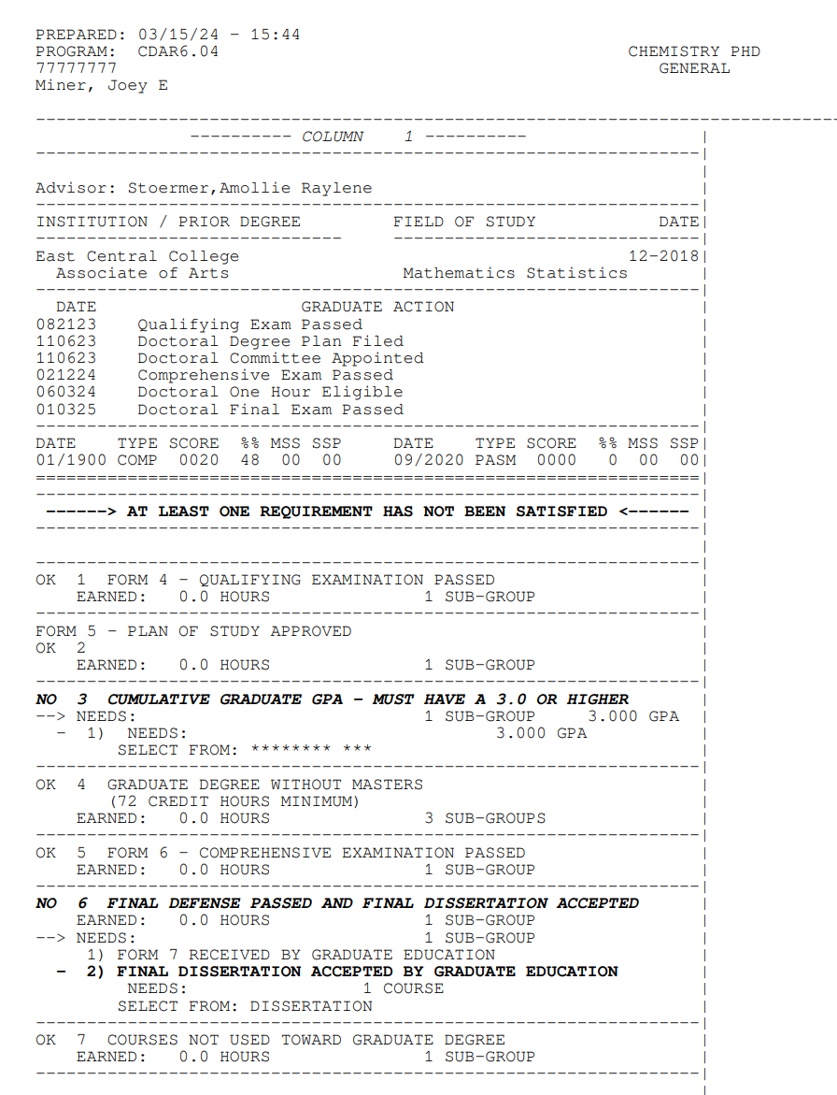
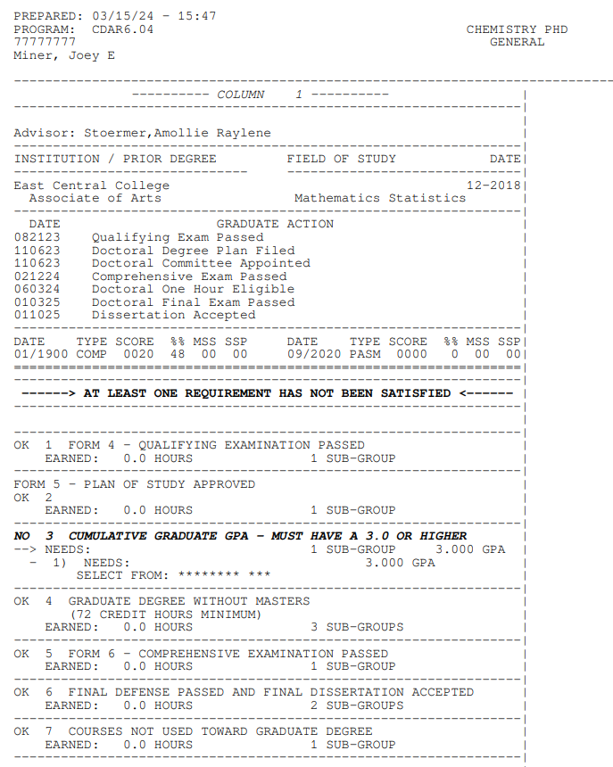
Tracking degree progress using degree audits (cont.)
Joe successfully completes his final exam on 1/3/2025. Form 7 is submitted.
Joe completes format checking process and final dissertation is accepted 1/10/25. Form 7 is approved. This is considered the degree completion date. The degree will be awarded after the spring semester closes and final grades are assigned. Spring semester enrollment is not required.

Slide 11
2024 Graduate Research Showcase
April 26, 2024, Havener Center
Poster and Oral Sessions
2 sessions
10:00 am – 12:00 pm
1:00 pm – 3:00 pm
Open to all graduate students
Deadline extended until April 1st
Judges needed!
Sign up for one or both sessions: https://forms.gle/zXNQ7Ps8bzUTStX76

Slide 12
Deadlines
Spring 2024 Final Semester Deadlines
Form 1A/5A – if changes to the plan of study and/or committee is needed
April 7
Thesis/dissertation first format check due (format checking is required)
April 7
Form 2/7: Results of final defense and approval of the thesis/dissertation
April 19
Final thesis/dissertation must be accepted by Graduate Education
May 3

Slide 13
Thank you!
No meeting in April!

